Slide 1
Hull Public Schools
FY24 Budget Presentation
February 27, 2023

Slide 2
District Priorities
Celebrate the accomplishments of our students, educators, staff, and district
Implement Phase 1 of the District Reconfiguration Plan
Develop blueprint for implementation of Phase 2 of District Reconfiguration Plan
Ensure all schools are diverse, inclusive, accepting, welcoming, and a safe place for everyone
Refine and streamline the District’s multi-tiered systems of support for academic and social emotional development
Expand student opportunities with a robust array of co-curricular activities
Uplift student voices by providing opportunities and fostering relationships
Continue to seek new pathways to improve communication with all stakeholders

Slide 3
District Priorities - Continued
Add a second full-day four year old pre-kindergarten classroom
Expand before and after school care for four year olds
Prioritize student success by ensuring high quality curriculum and instruction that supports all student academic and social emotional needs
Adopt and implement an English Language Arts curriculum PreK-7 aligned to the Massachusetts State Standards
Pilot new Spanish curriculum for grades 7-12
Refine our multi-year Curriculum Review Cycle for all content areas PreK-12
Broaden use of Naviance 8-12 to support a comprehensive school guidance program

Slide 4
District Priorities - Continued
Increase and diversify course catalog of electives
Provide professional development time for staff to continue curriculum mapping on the Chalk Curriculum Platform, focusing on the analytics for alignment to Massachusetts State Standards as well as vertical and horizontal articulation
Continue our commitment to being a data-driven school district using District Benchmark software for ELA, Math & Science
Maintain two curriculum leaders at Hull High School for leadership and support in ELA/History and Math/Science
Emphasize our comprehensive, highly-effective, and robust student focused in-house special education programs
Invest in technology and safe, well maintained facilities to create an environment for success in teaching and learning

Slide 5
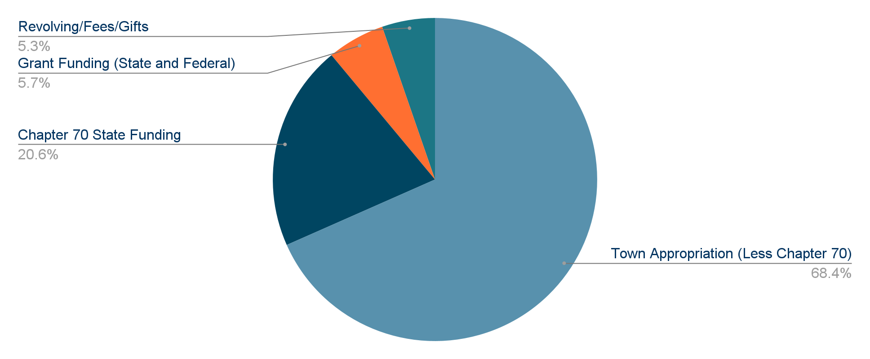
Sources of Funds
Chapter 70 and Town Appropriation
Revolving Funds
Federal and State Grant Funds
Special Education Circuit Breaker reimbursement

Slide 6
Esser Funds
Emergency funding to address the COVID-19 Pandemic
Funds to support three main areas, Academics, Social-Emotional needs, and Operations
Address the academic, social, emotional, and mental health needs of students
20% of ESSER III funds must be used to address learning loss due to loss of instructional time
Address the disproportionate impact of COVID-19 on underrepresented student subgroups
ESSER I - The Coronavirus Aid, Relief, and Economic Security Cares Act (CARES)
Signed into law March 27, 2020
$122,779
ESSER II - Coronavirus Response and Relief Supplemental Appropriations Act (CRRSA)
Signed into law December 27, 2020
$422,179
ESSER III - American Rescue Plan Act (ARP)
Signed into law March 11, 2021
$962,051

Slide 7
Esser Funds
Curriculum/Learning Loss/Accelerating Learning $982,591
Jacobs School Staff to ensure small class size FY22-24
Building based substitutes to provide consistent coverage FY22-24
Middle School scheduling consult and increase art .34 FY22
.8 PreK paraprofessional FY23-24
High School instructional leaders ELA/History and Math/Science FY22-24
IXL Math Subscription FY23-25
Jacobs School ELA Curriculum
Middle School Social Studies Curriculum FY23
Galileo student assessment license FY23-24
Curriculum Map platform CHALK FY23-24
Math interventionist K-5 (.5) FY23-24
Jacobs School PreK .5 FY24
Jacobs School Library consultation FY23-24
SMART panels FY23-24

Slide 8
Esser Funds
Social Emotional Learning/Mental Health $279,206
Intramural track program grades 6 & 7 FY22-24
Scholarships to summer recreation program FY21-24
Improvements to High School fitness center FY22
Increased hours of athletic trainer FY23
High School picnic tables for outdoor dining in the courtyard FY22
Nature’s Classroom grade 6 FY22-24
Theatre equipment upgrades FY24
Middle School grade 7 Rowing Program FY23-24

Slide 9
Esser Funds
Diversity, Equity, and Inclusion $115,026
Raising Multicultural Kids/Advocacy in Action Programs FY22-24
Differentiation PD/Stipends FY24
Gaming Technology E-Sports Program grades 8 - 12 FY23-24
Middle School Unified Sports Program with SSEC FY23-24
Learning Walks FY24
Operations/Facilities/PPE COVID Testing $130,186
Replace carpet in the main office and exhibition room at Hull High School FY22
Replace Jacobs School food service steamer FY22
Landscape Improvements FY23-24
Jacobs School Cafeteria Video Upgrade FY22

Slide 10
Budget Comparison
 | FY20 Actuals * | FY21 Actuals | FY22 Actuals | FY23 Appropriation | FY24 Proposed
Total Town Appropriated Expenditures | $15,678,874 | $16,017,295 | $16,339,610 | $16,829,840 | $17,334,735
Increase Over Previous Year | 247,555 | 338,421 | 322,315 | 490,230 | 504,895
% Change From Previous Year | 1.21% | 2.16% | 2.01% | 3.00% | 3.00%

Slide 11
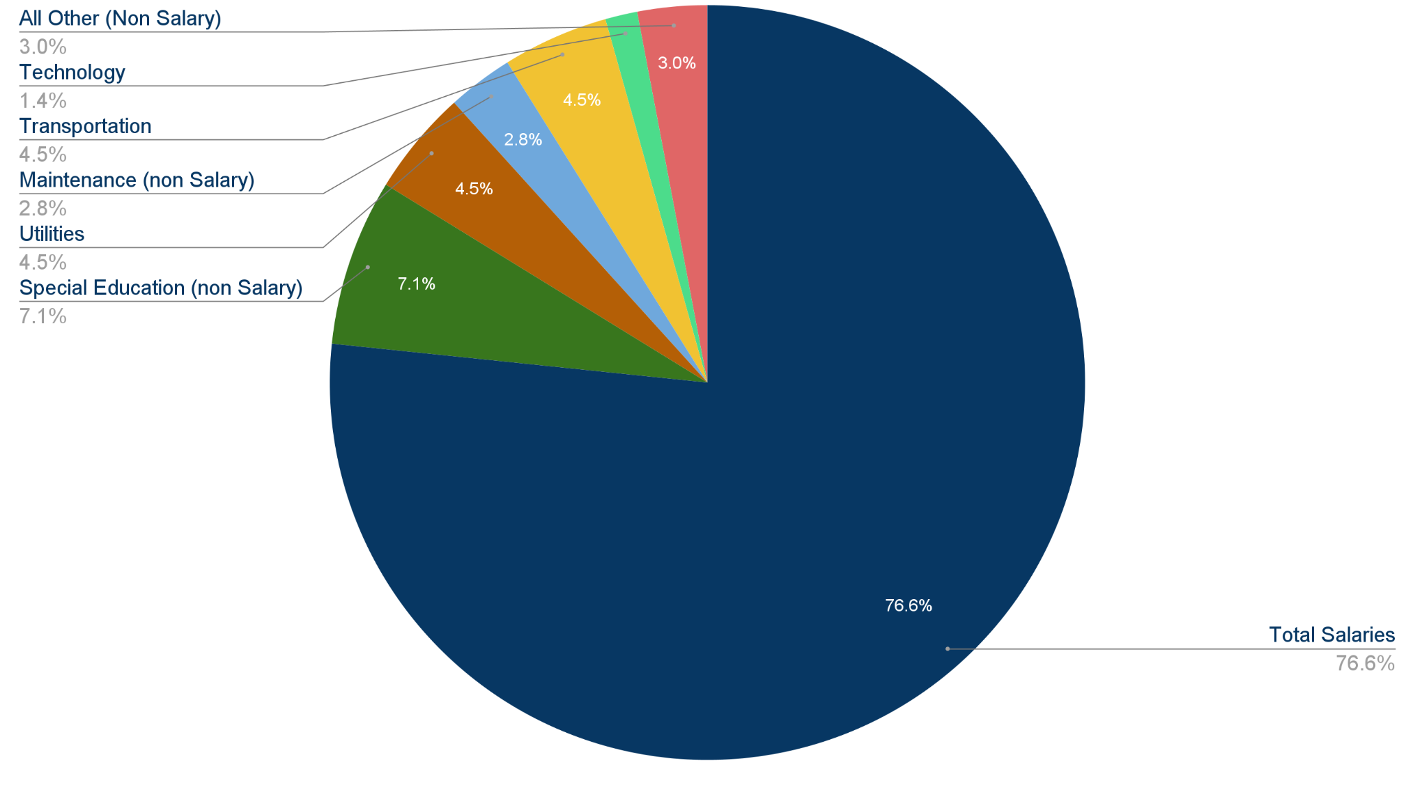
FY24 Budget By Major Category
Total Salaries | 13,285,736 | 76.64%
Special Education (non Salary) | 1,238,226 | 7.14%
Utilities | 781,651 | 4.51%
Maintenance (non Salary) | 488,371 | 2.82%
Transportation | 785,557 | 4.53%
Technology | 238,009 | 1.37%
All Other (Non Salary) | 517,185 | 2.99%
FY24 Proposed Budget | 17,334,735 | 100%

Slide 12
Upcoming Budget Discussions
School Committee Meetings Monday, March 13, 2023 - Regular Meeting
Monday, March 27, 2023 - Joint meeting at Town Hall with Advisory Board 7pm
Monday, April 10, 2023 - Public Hearing on FY24 budget
Monday, April 24, 2023 - Regular Meeting
Monday, May 1, 2023 - Town Meeting at Hull High School

